Slide 1

Content-based Recommender System
Utilizing User Data
(Applied Data Science Capstone)
Jay Mitchell
1/15/2020

Slide 2
Venue locations value
Service providers
- Capitalize on data (e.g., Foursquare, Mint)
Customers
- Find amenities similar to those normally used
Venues
- New patrons may increase sales

Slide 3
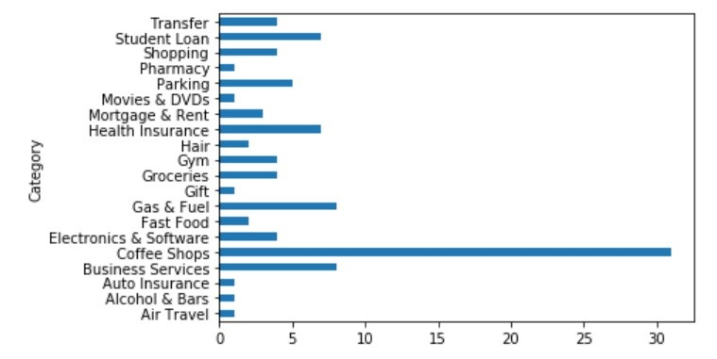
Data acquisition and cleaning
Mint
- Text file downloaded from website
- Select columns and rows of interest to generate categories
- Compare categories by statistical means (generate NormScore)
Foursquare
- Use Mint categories as search terms
- Locate nearby venues using location
- Find ratings for each venue

Slide 4
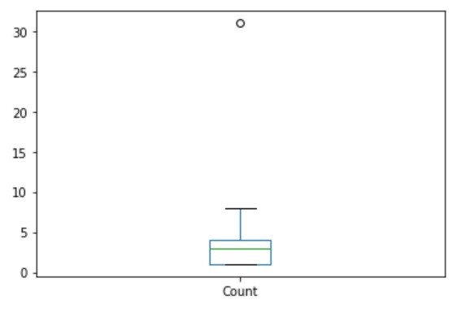
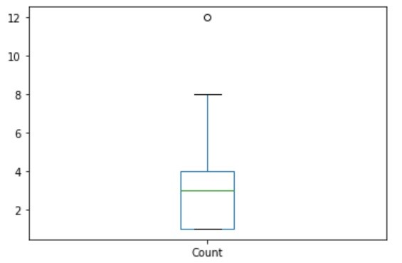
Outliers

Slide 5
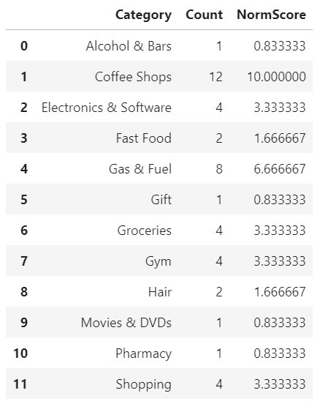
Initial Results - Mint
Simple feature scaling
- Positive values
- 0 to 1
- Multiplied by 10 to equal venue rating weight (0 to 10 scale)
- NormScore

Slide 6
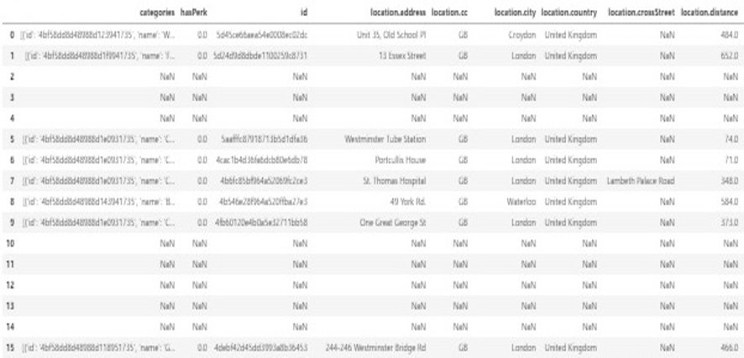
Initial Results - Foursqure

Slide 7
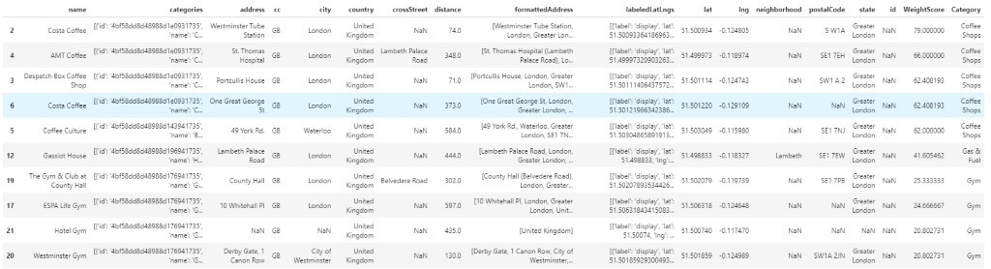
Final Results - Combined
Venue rating and NormScore generated Weightscore
Top 10 venues
Venue Name, Latitude, and Longitude for map

Slide 8
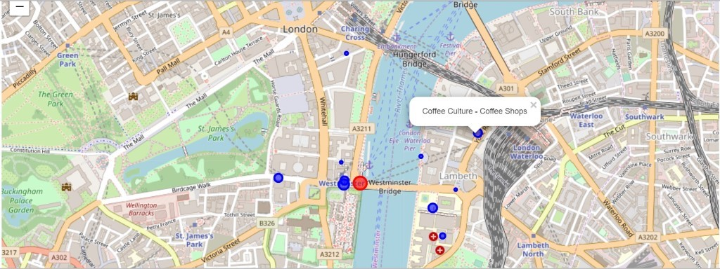
Output
Folium mapping tool
Current location (Large red dot)
Venues (Blue dots with the radius proportional to WeightScore)
Interactable (venue name and category)

Slide 9
Discussion
Effective at generating local venues
Data
- Utilize other data sources based on the particular user
- Update data from time to time to ensure relevancy
- More generalized categories may be used
- k means clustering algorithm to determine similar categories
Processing
- Final recommendation skewed
- Counts may not be the best way to determine a user profile
- Reduce the impact of outliers
- Binning Profit
Profit
- Popup label hyperlink to incentive
- Include income to data providers and app developer

Slide 10
Conclusion
Recommendation engine profiled a user
Historical data
Determine nearby venues
Venues rating
Interactive Folium map
Code: https://github.com/jmitchell4390/Coursera_Capstone/blob/master/Capstone_Project.ipynb
Map: https://nbviewer.jupyter.org/github/jmitchell4390/Coursera_Capstone/blob/master/Capstone_Project.ipynb
Data: https://github.com/jmitchell4390/Coursera_Capstone/blob/master/transactions.txt

